Slide 1
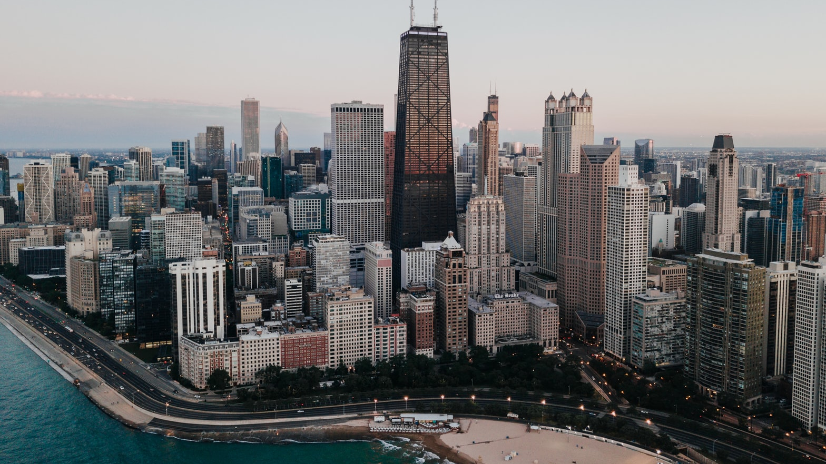
Criminality in Chicago Project Proposal
MDS@FCUP
Vasco Campos
Nuno Costa

Slide 2
Understanding the data
Dataset consisting of over 6 millions entries of registered crimes in the city of Chicago, from 2001 to 2017, divided in 4 chunks.
Exploring features: What is their meaning, how are they distributed over space and time, further derivations .

Slide 3
Asking questions
What are the safest areas in Chicago?
How did the safety levels develop with time?
Is the city safer than before?
Are the efforts in mitigating crime being effective and contributing to a safer society?
Is the police focusing on the right things?

Slide 4
Asking questions
Does crime follow any temporal pattern?
Are police funds sufficient? Can they handle the number of crimes in their section?

Slide 5
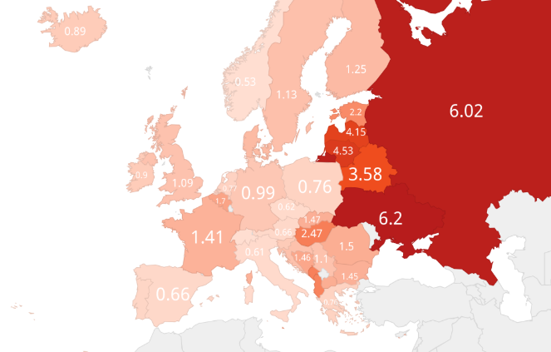
Placing hypothesis
We believe crime has decreased in general terms, but there might be differences across segments.
We believe the police might not be addressing crime types in proportion to their volume/seriousness.
We believe there might be some problems related to police staffing, making them less reactive to simultaneous crimes in the same location.

Slide 6
Things found on the internet

Slide 7

Challenges ahead
Scaling seriousness of crimes
Modelling a function for safety
Deciding on resolution vs simplicity
Obtaining a good representation through sampling
Transmitting simultaneously the levels of safety for the present and what was their time evolution
And more…
$${Safety}_{t}\left(place\right)= \frac{\sum{c_{i}}}{\sum{a_{i}c_{i}}}$$

Slide 8
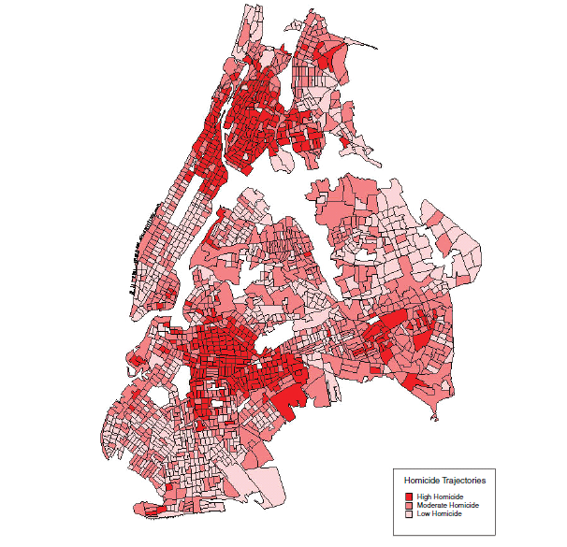
Things found on the internet

